Slide 1

By: Dinesh Bhatia

Slide 2
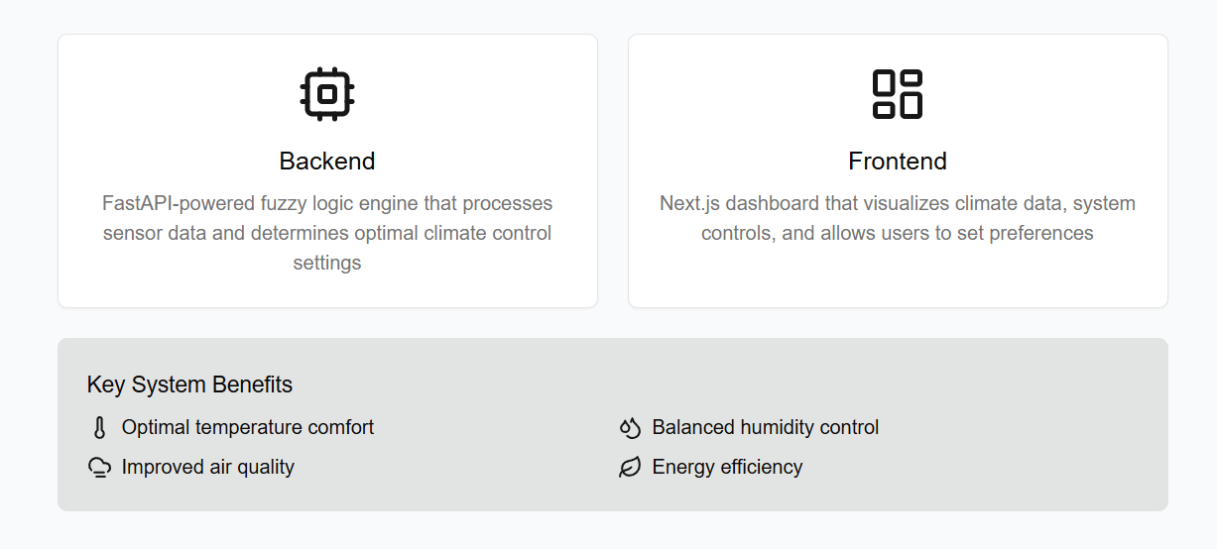
Overview

Slide 3
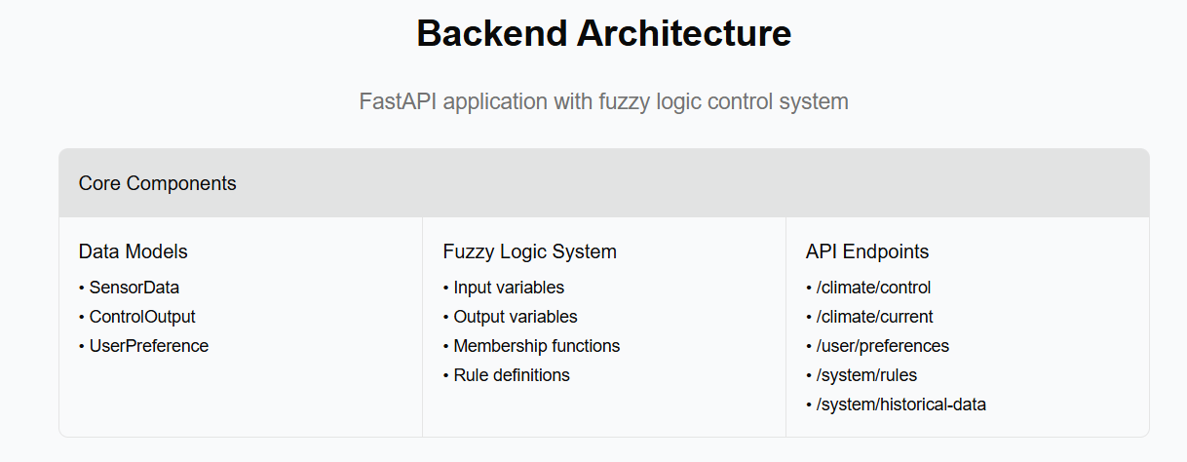

Slide 4
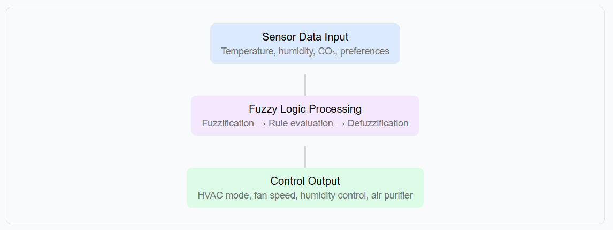
Fuzzy Logic Control Flow

Slide 5

Frontend Architecture

Slide 6

Frontend Control Flow

Slide 7
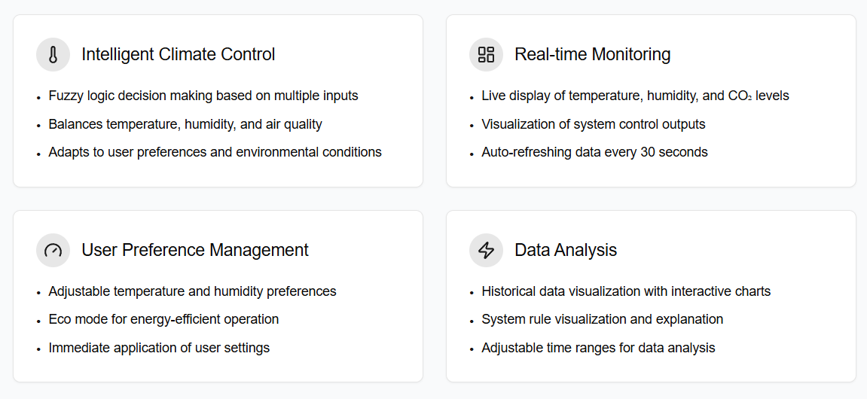
Key Features

Slide 8
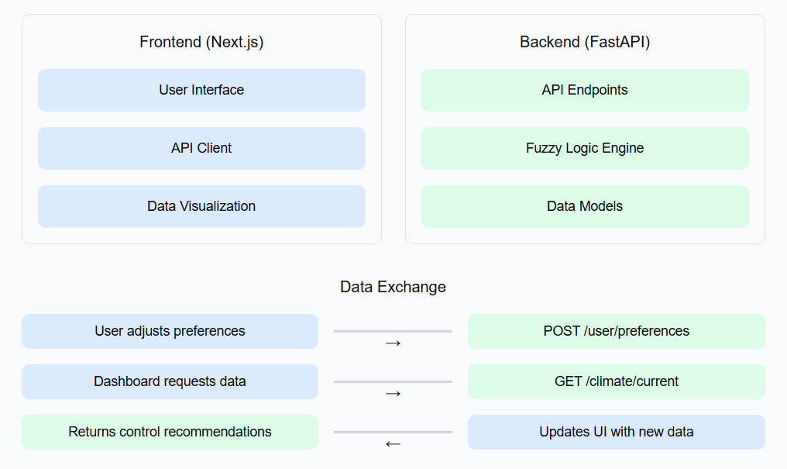
System Data Flow

Slide 9
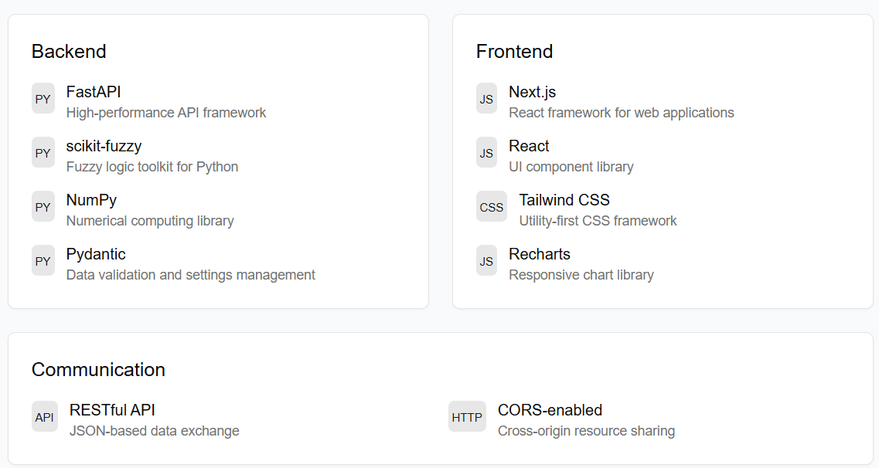
Technologies Used

Slide 10
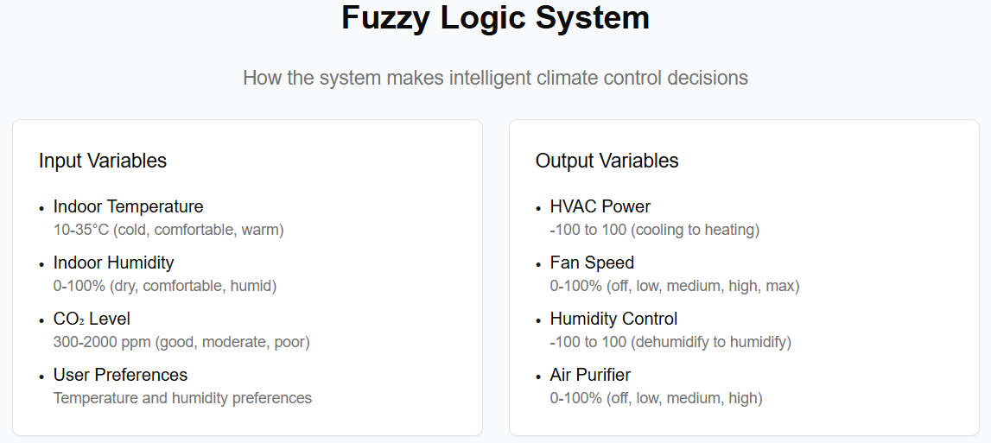

Slide 11
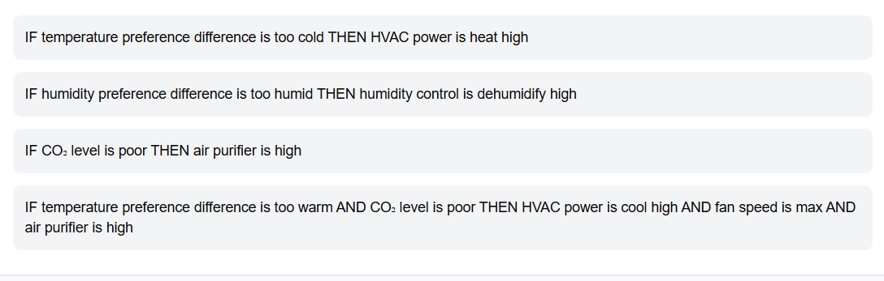
Fuzzy Rules Example

Slide 12
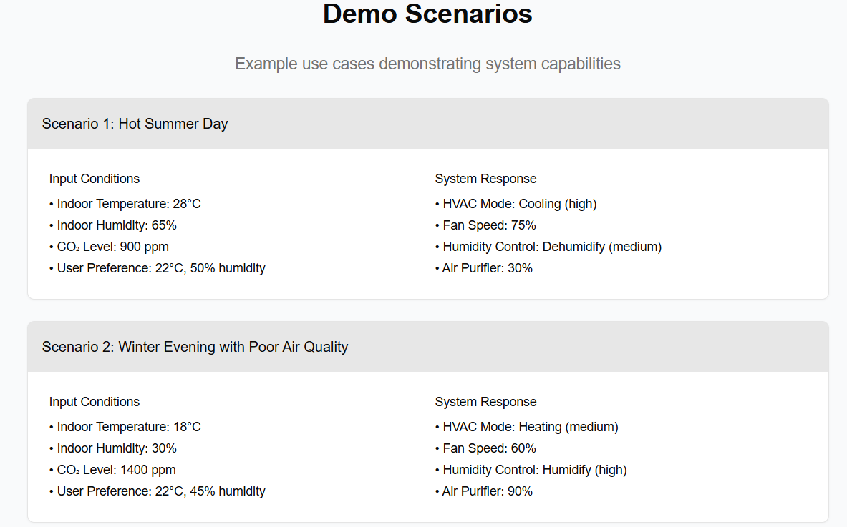

Slide 13


